Slide 1
MODULE-I
Module I | SOFTWARE ENGINEERING AND SOFTWARE PROCESS | (09Period)
Engineering Layers; The Software Process, Software Engineering Practice, Software myths. Process models: A Generic Process Model, Prescriptive Process Models-The Waterfall Model, Incremental Process Models, Specialized Process Models; The Unified Process, Agile Development-Agility, Agile Process, Extreme Programming (XP), Scrum, Lean Software Development (LSD), Dynamic System Development Method, Agile Modeling (AM), Agile Unified Process (AUP), The Cleanroom strategy.

Slide 2
ENGINEERING LAYERS
1. A quality focus: It defines the continuous process improvement principles of software. It provides integrity that means providing security to the software so that data can be accessed by only an authorized person, no outsider can access the data. It also focuses on maintainability and usability.
2. Process: It is the foundation or base layer of software engineering. It is key that binds all the layers together which enables the development of software before the deadline or on time. Process defines a framework that must be established for the effective delivery of software engineering technology. The software process covers all the activities, actions, and tasks required to be carried out for software development.

Slide 3
ENGINEERING LAYERS
Process activities are listed below:-
Communication: It is the first and foremost thing for the development of software. Communication is necessary to know the actual demand of the client.
Planning: It basically means drawing a map for reduced the complication of development.
Modeling: In this process, a model is created according to the client for better understanding.
Construction: It includes the coding and testing of the problem.
Deployment:- It includes the delivery of software to the client for evaluation and feedback.

Slide 4
ENGINEERING LAYERS
3. Method: During the process of software development the answers to all “how-to-do” questions are given by method. It has the information of all the tasks which includes communication, requirement analysis, design modeling, program construction, testing, and support.
4. Tools: Software engineering tools provide a self-operating system for processes and methods. Tools are integrated which means information created by one tool can be used by another.

Slide 5
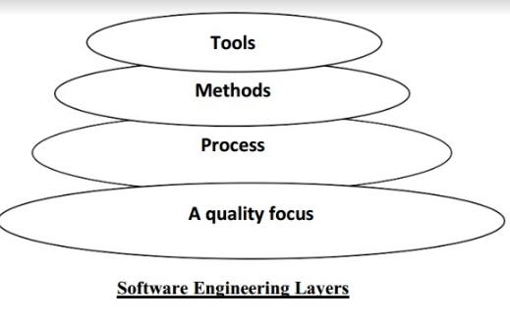
ENGINEERING LAYERS

Slide 6
THE SOFTWARE PROCESS
A software process (also knows as software methodology) is a set of related activities that leads to the production of the software. These activities may involve the development of the software from the scratch, or, modifying an existing system.
Any software process must include the following four activities:
1. Software specification : Define the main functionalities of the software and the constrains around them.
2. Software design and implementation: The software is to be designed and programmed.
3. Software verification and validation: The software must conforms to it’s specification and meets the customer needs.

Slide 7
THE SOFTWARE PROCESS
4. Software evolution : The software is being modified to meet customer and market requirements changes. In practice, they include sub-activities such as requirements validation, architectural design, unit testing, …etc.

Slide 8
SOFTWARE ENGINEERING PRACTICE
The process encompasses the entire range of activities, from initial customer inception to software production and maintenance. It's also known as the Software Development Life Cycle (SDLC).
Step 1: Understanding Customer Requirements
This step is also known as the ''requirements collection'' step. It's all about communicating with the customer before building a software, so you get to know their requirements thoroughly. It's usually conducted by a business analyst or product analyst. A Customer Requirement Specification (CRS) document is written from a customer's perspective and describes, in a simple way, what the software is going to do.

Slide 9
SOFTWARE ENGINEERING PRACTICE
Step 2: Requirement Analysis: Is the Project Feasible?
This stage involves exploring issues related to the financial, technical, operational, and time management aspects of software development. It's an essential step towards creating functional specifications and design. It's usually done by a team of product managers, business analysts, software architects, developers, HR, and finance managers.
Step 3: Creating a Design
Once the analysis stage is over, it's time to create a blueprint for the software. Architects and senior developers create a high-level design of the software architecture, along with a low-level design describing how each and every component in the software should work.

Slide 10
SOFTWARE ENGINEERING PRACTICE
Step 4: Coding, Testing, and Installation
Next, software developers implement the design by writing code. After all the code developed by different teams is integrated, test engineers check if the software meets the required specifications, so that developers can debug code.
Step 5: Keeping it Going: Maintenance
Maintenance is the application of each of the previous steps to the existing modules in the software in order to modify or add new features, depending on what the customer needs.

Slide 11
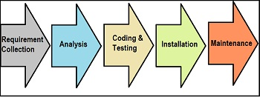
SOFTWARE ENGINEERING PRACTICE

Slide 12
SOFTWARE MYTHS
Software Myths- beliefs about software and the process used to build it - can be traced to the earliest days of computing.
Management Myths : Managers with software responsibility, like managers in most disciplines, are often under pressure to maintain budgets, keep schedules from slipping, and improve quality. Like a drowning person who grasps at a straw, a software manager often grasps at belief in a software myth.
Myth : We already have a book that’s full of standards and procedures for building software. Won’t that provide my people with everything they need to know?
Reality : The book of standards may very well exist, but is it used? Are software practitioners aware of its existence? Does it reflect modern software engineering practice? Is it complete?

Slide 13
SOFTWARE MYTHS
Myth: My people have state-of-the-art software development tools, after all, we buy them the newest computers.
Reality: It takes much more than the latest model mainframe, workstation, or PC to do high-quality software development. Computer-aided software engineering (CASE) tools are more important than hardware for achieving good quality and productivity, yet the majority of software developers still do not use them effectively.
Myth: If I decide to outsource the software project to a third party, I can just relax and let that firm build it.
Reality: If an organization does not understand how to manage and control software projects internally, it will invariably struggle when it outsources software projects.

Slide 14
SOFTWARE MYTHS
2) Customer myths: Customer myths lead to false expectations and ultimately, dissatisfaction with the developer. Following are the customer myths:
Myth: A general statement of objectives is sufficient to begin writing programs-we can fill in the details later.
Reality: A poor up-front definition is the major cause of failed software efforts. A formal and detailed description of the functions, behavior, performance, interfaces, design constraints, and validation criteria is essential.

Slide 15
SOFTWARE MYTHS
Myth: Project requirements continually change, but change can be easily accommodated because software is flexible.
Reality: It is true that software requirements change, but the impact of change varies with the time at which it is introduced. When changes are requested during software design, the cost impact grows rapidly. Resources have been committed and a design framework has been established. Change can cause heavy additional costs. Change, when requested after software is in production, can be much more expensive than the same change requested earlier.

Slide 16
SOFTWARE MYTHS
3) Practitioner’s myths: Practitioners have following myths:
Myth: Once we write the program and get it to work, our job is done.
Reality: Industry data indicate that between 60 and 80 percent of all effort expended on software will be expended after it is delivered to the customer for the first time.
Myth: Until I get the program “running” I have no way of assessing its quality.
Reality: One of the most effective software quality assurance mechanisms can be applied from the inception of a project—the formal technical review.

Slide 17
A GENERIC PROCESS MODEL
The generic process model is an abstraction of the software development process. It is used in most software since it provides a base for them.
The generic process model encompasses the following five steps:
Communication
Planning
Modelling
Construction
Deployment

Slide 18
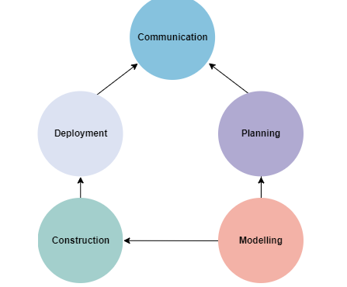
A GENERIC PROCESS MODEL

Slide 19
A GENERIC PROCESS MODEL
Communication
In this step, we communicate with the clients and end-users. We discuss the requirements of the project with the users. The users give suggestions on the project. If any changes are difficult to implement, we work on alternative ideas.
Planning
In this step, we plan the steps for project development. After completing the final discussion, we report on the project. Planning plays a key role in the software development process. We discuss the risks involved in the project.

Slide 20
A GENERIC PROCESS MODEL
Modelling
In this step, we create a model to understand the project in the real world. We showcase the model to all the developers. If changes are required, we implement them in this step. We develop a practical model to get a better understanding of the project.
Construction
In this step, we follow a procedure to develop the final product. If any code is required for the project development, we implement it in this phase. We also test the project in this phase.
Deployment
In this phase, we submit the project to the clients for their feedback and add any missing requirements. We get the client feedback. Depending on the feedback form, we make the appropriate changes.

Slide 21
THE WATERFALL MODEL
Waterfall approach was first SDLC Model to be used widely in Software Engineering to ensure success of the project. In "The Waterfall" approach, the whole process of software development is divided into separate phases.
Requirement Gathering and analysis − All possible requirements of the system to be developed are captured in this phase and documented in a requirement specification document.
System Design − The requirement specifications from first phase are studied in this phase and the system design is prepared. This system design helps in specifying hardware and system requirements and helps in defining the overall system architecture.

Slide 22
THE WATERFALL MODEL
Implementation − With inputs from the system design, the system is first developed in small programs called units, which are integrated in the next phase. Each unit is developed and tested for its functionality, which is referred to as Unit Testing.
Integration and Testing − All the units developed in the implementation phase are integrated into a system after testing of each unit. Post integration the entire system is tested for any faults and failures.
Deployment of system − Once the functional and non-functional testing is done; the product is deployed in the customer environment or released into the market.

Slide 23
THE WATERFALL MODEL
Maintenance − There are some issues which come up in the client environment. To fix those issues, patches are released. Also to enhance the product some better versions are released. Maintenance is done to deliver these changes in the customer environment.
All these phases are cascaded to each other in which progress is seen as flowing steadily downwards (like a waterfall) through the phases.

Slide 24
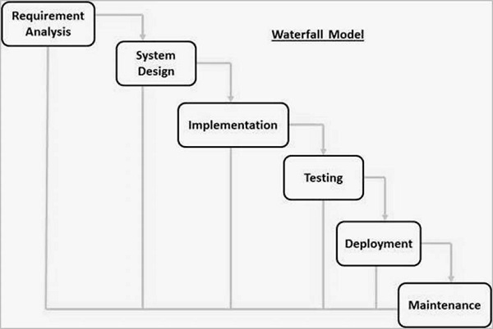
THE WATERFALL MODEL

Slide 25
THE WATERFALL MODEL
Waterfall Model – Advantages
A schedule can be set with deadlines for each stage of development and a product can proceed through the development process model phases one by one.
Development moves from concept, through design, implementation, testing, installation, troubleshooting, and ends up at operation and maintenance. Each phase of development proceeds in strict order.
Simple and easy to understand and use
Phases are processed and completed one at a time.
Works well for smaller projects where requirements are very well understood.

Slide 26
THE WATERFALL MODEL
Waterfall Model - Disadvantages
The disadvantage of waterfall development is that it does not allow much reflection or revision. Once an application is in the testing stage, it is very difficult to go back and change something that was not well-documented or thought upon in the concept stage.
No working software is produced until late during the life cycle.
High amounts of risk and uncertainty.
Not a good model for complex and object-oriented projects.
Poor model for long and ongoing projects.
It is difficult to measure progress within stages.
Cannot accommodate changing requirements.
Adjusting scope during the life cycle can end a project.

Slide 27
INCREMENTAL PROCESS MODEL
In this model, each module goes through the requirements, design, implementation and testing phases. Every subsequent release of the module adds function to the previous release. The process continues until the complete system achieved.

Slide 28
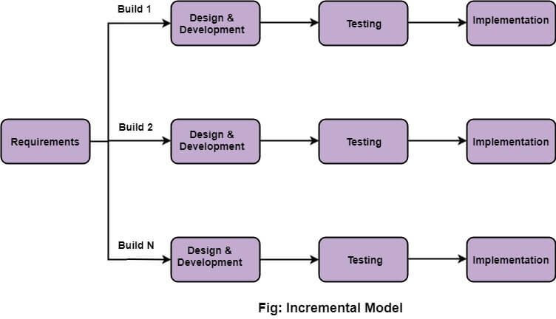
INCREMENTAL PROCESS MODEL

Slide 29
INCREMENTAL PROCESS MODEL
1. Requirement analysis: In the first phase of the incremental model, the product analysis expertise identifies the requirements. To develop the software under the incremental model, this phase performs a crucial role.
2. Design & Development: In this phase of the Incremental model of SDLC, the design of the system functionality and the development method are finished with success. When software develops new practicality, the incremental model uses style and development phase.

Slide 30
INCREMENTAL PROCESS MODEL
3. Testing: In the incremental model, the testing phase checks the performance of each existing function as well as additional functionality. In the testing phase, the various methods are used to test the behavior of each task.
4. Implementation: Implementation phase enables the coding phase of the development system. It involves the final coding that design in the designing and development phase and tests the functionality in the testing phase. After completion of this phase, the number of the product working is enhanced and upgraded up to the final system product.

Slide 31
INCREMENTAL PROCESS MODEL
Advantage of Incremental Model
Errors are easy to be recognized.
Easier to test and debug
More flexible.
Simple to manage risk because it handled during its iteration.
The Client gets important functionality early.
Disadvantage of Incremental Model
Need for good planning
Total Cost is high.

Slide 32
SPECIALIZED PROCESS MODEL
Component-Based Development(CBD)
The component Based Development Model has the characteristics of a spiral model, hence is evolutionary and iterative in nature.
In this model, applications are built from pre-packaged software components that are available from different vendors.
Components are modular products with well-defined functions that can be incorporated into the project of selection.
The modelling and construction stages are begun with identifying candidate components suitable for the project.

Slide 33
SPECIALIZED PROCESS MODEL
Formal Methods Model(FMM)
In the Formal Methods Model, mathematical methods are applied in the process of developing software. It Uses Formal Specification Language (FSL) to define each system characteristics.
FSL defines the syntax, notations for representing system specifications, several objects and relations to define the system in detail.
The careful mathematical analysis that is done in FMM results in a defect-free system. It also helps to identify and correct ambiguity and inconsistency easily. This method is time-consuming and expensive in nature.

Slide 34
UNIFIED PROCESS
Unified process (UP) is an architecture centric, use case driven, iterative and incremental development process.
UP is also referred to as the unified software development process.
The Unified Process is an attempt to draw on the best features and characteristics of traditional software process models, but characterize them in a way that implements many of the best principles of agile software development.
The Unified Process recognizes the importance of customer communication and streamlined methods for describing the customer’s view of a system.
It emphasizes the important role of software architecture and “helps the architect focus on the right goals, such as understandability, reliance to future changes, and reuse”.

Slide 35
AGILE DEVELOPMENT-AGILITY
"Agile process model" refers to a software development approach based on iterative development.
Agile methods break tasks into smaller iterations, or parts do not directly involve long term planning. The project scope and requirements are laid down at the beginning of the development process.
Plans regarding the number of iterations, the duration and the scope of each iteration are clearly defined in advance.

Slide 36
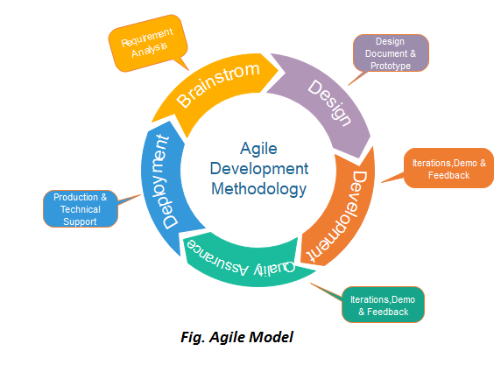
AGILE DEVELOPMENT-AGILITY

Slide 37
AGILE DEVELOPMENT-AGILITY
Following are the phases in the Agile model are as follows:
Requirements gathering
Design the requirements
Construction/ iteration
Testing/ Quality assurance
Deployment
Feedback

Slide 38
AGILE DEVELOPMENT-AGILITY
Requirements gathering: In this phase, you must define the requirements. You should explain business opportunities and plan the time and effort needed to build the project. Based on this information, you can evaluate technical and economic feasibility.
Design the requirements: When you have identified the project, work with stakeholders to define requirements. You can use the user flow diagram or the high-level UML diagram to show the work of new features and show how it will apply to your existing system.
Construction/ iteration: When the team defines the requirements, the work begins. Designers and developers start working on their project, which aims to deploy a working product.

Slide 39
AGILE DEVELOPMENT-AGILITY
Testing: In this phase, the Quality Assurance team examines the product's performance and looks for the bug.
Deployment: In this phase, the team issues a product for the user's work environment.
Feedback: After releasing the product, the last step is feedback. In this, the team receives feedback about the product and works through the feedback.

Slide 40
EXTREME PROGRAMMING (XP)
Extreme programming (XP) is one of the most important software development frameworks of Agile models. It is used to improve software quality and responsiveness to customer requirements.
Some of the good practices that have been recognized in the extreme programming model and suggested to maximize their use are given below:
1. Code Review: Code review detects and corrects errors efficiently. It suggests pair programming as coding and reviewing of written code carried out by a pair of programmers who switch their works between them every hour.
2. Testing: Testing code helps to remove errors and improves its reliability. XP suggests test-driven development (TDD) to continually write and execute test cases. In the TDD approach test cases are written even before any code is written.

Slide 41
EXTREME PROGRAMMING (XP)
3. Incremental development: Incremental development is very good because customer feedback is gained and based on this development team comes up with new increments every few days after each iteration.
4. Simplicity: Simplicity makes it easier to develop good quality code as well as to test and debug it.
5. Design: Good quality design is important to develop good quality software. So, everybody should design daily.
6. Integration testing: It helps to identify bugs at the interfaces of different functionalities. Extreme programming suggests that the developers should achieve continuous integration by building and performing integration testing several times a day.

Slide 42
SCRUM
SCRUM is an agile development process focused primarily on ways to manage tasks in team-based development conditions.
There are three roles in it, and their responsibilities are:
Scrum Master: The scrum can set up the master team, arrange the meeting and remove obstacles for the process
Product owner: The product owner makes the product backlog, prioritizes the delay and is responsible for the distribution of functionality on each repetition.
Scrum Team: The team manages its work and organizes the work to complete the sprint or cycle.

Slide 43
LEAN SOFTWARE DEVELOPMENT (LSD)
DSDM (dynamic systems development method ) is a rapid application development strategy for software development and gives an agile project distribution structure.
The essential features of DSDM are that users must be actively connected, and teams have been given the right to make decisions. The techniques used in DSDM are:
Time Boxing
MoSCoW Rules
Prototyping

Slide 44
DYNAMIC SYSTEM DEVELOPMENT METHOD
The DSDM project contains seven stages:
Pre-project
Feasibility Study
Business Study
Functional Model Iteration
Design and build Iteration
Implementation
Post-project

Slide 45
DYNAMIC SYSTEM DEVELOPMENT METHOD
Feasibility study – In order to determine if an application is a good fit for the DSDM process, it is necessary to first establish the fundamental business requirements and constraints connected with the application.
Business Study – Establishes the functional and information requirements that must be met in order for the application to be able to give value to the company, as well as specifies the fundamental architecture of the application and outlines the needs that must be met for the application to be maintainable.
Implementation – Installs the most recent software update available into the environment in which it is now running.

Slide 46
DYNAMIC SYSTEM DEVELOPMENT METHOD
Feature Driven Development(FDD):
This method focuses on "Designing and Building" features. In contrast to other smart methods, FDD describes the small steps of the work that should be obtained separately per function.
Lean Software Development:
Lean software development methodology follows the principle "just in time production." The lean method indicates the increasing speed of software development and reducing costs. Lean development can be summarized in seven phases.

Slide 47
AGILE MODELING (AM)
Agile modeling as “…a practice-based methodology for effective modeling and documentation of software-based systems. Simply put, Agile Modeling (AM) is a collection of values, principles, and practices for modeling software that can be applied on a software development project in an effective and lightweight manner.”
The modeling adds to existing Agile methodologies such as the Rational Unified Process (RUP) or extreme programming (XP).
Agile modeling helps developers create a customized software development process that fulfills their development needs yet is flexible enough to adjust to future situations.

Slide 48
AGILE UNIFIED PROCESS (AUP)
Model: A model is an abstraction that expresses important aspects of a thing or concepts. Models may be visual, non-visual, or executable (working code or equivalent). Models are sometimes called maps or roadmaps within the agile community.
Agile model: Agile models can be something as simple as stickies on a wall, sketches on a whiteboard, diagrams captured digitally via a drawing tool, or detailed models captured using a model-based software engineering (MBSE) tool.
Modeling: Modeling is the act of creating a model. Modeling is sometimes called mapping.

Slide 49
AGILE UNIFIED PROCESS (AUP)
Agile modeling: Agile modeling is modeling performed in a collaborative and evolutionary manner.
Document: A document is a persistent representation of a thing or concept. A document is a model, but not all models are documents
Agile document: Agile documents can be as point-form notes, detailed text, executable tests, or one or more agile models.

Slide 50
THE CLEANROOM STRATEGY
Clean room software development approaches consist of four key processes
Management –
It is persistent throughout the whole project lifetime which consists of project mission, schedule, resources, risk analysis, training, configuration management, etc.
Specification –
It is considered the first process of each increment which consists of requirement analysis, function specification, usage specification, increment planning, etc.

Slide 51
THE CLEANROOM STRATEGY
Development –
It is considered the second process of each increment which consists of software reengineering, correctness verification, incremental design, etc.
Certification –
It is considered the final process of each increment which consists of usage modeling and test planning, statistical training and certification process, etc.

